Slide 1
FLOW CONTROL

Slide 2
FLOW AND ERROR CONTROL
The most important responsibilities of the data link layer are flow control and error control. Collectively, these functions are known as data link control.
Flow Control
Error Control

Slide 3
Flow control refers to a set of procedures used to restrict the amount of data
that the sender can send before
waiting for acknowledgment.
Error control in the data link layer is based on automatic repeat request, which is the retransmission of data.

Slide 4
PROTOCOLS
How the data link layer can combine framing, flow control, and error control to achieve the delivery of data from one node to another. The protocols are normally implemented in software by using one of the common programming languages.

Slide 5

Taxonomy of protocols

Slide 6
NOISELESS CHANNELS
In which no frames are lost, duplicated, or corrupted. We introduce two protocols for this type of channel.
Simplest Protocol
Stop-and-Wait Protocol

Slide 7

The design of the simplest protocol with no flow or error control

Slide 8

Flow diagram

Slide 9
Stop-and-Wait Protocol

Slide 10

Design of Stop-and-Wait Protocol
Figure shows an example of communication using this protocol. It is still very simple. The sender sends one frame and waits for feedback from the receiver. When the ACK arrives, the sender sends the next frame. Note that sending two frames in the protocol involves the sender in four events and the receiver in two events.

Slide 11

Flow diagram

Slide 12
NOISY CHANNELS
Stop-and-Wait Protocol gives us an idea of how to add flow control to its predecessor, noiseless channels are nonexistent.
Stop-and-Wait Automatic Repeat Request
Go-Back-N Automatic Repeat Request
Selective Repeat Automatic Repeat Request

Slide 13
Error correction in Stop-and-Wait ARQ is done by keeping a copy of the sent frame and retransmitting of the frame when the timer expires.
In Stop-and-Wait ARQ, we use sequence numbers to number the frames.
The sequence numbers are based on modulo-2 arithmetic.
In Stop-and-Wait ARQ, the acknowledgment number always announces in modulo-2 arithmetic the sequence number of the next frame expected.

Slide 14

Design of the Stop-and-Wait ARQ Protocol

Slide 15
Figure shows an example of Stop-and-Wait ARQ. Frame 0 is sent and acknowledged. Frame 1 is lost and resent after the time-out. The resent frame 1 is acknowledged and the timer stops. Frame 0 is sent and acknowledged, but the acknowledgment is lost. The sender has no idea if the frame or the acknowledgment is lost, so after the time-out, it resends frame 0, which is acknowledged.

Slide 16

Flow diagram for Example

Slide 17
Go-Back-N Protocol

Slide 18
In the Go-Back-N Protocol, the sequence numbers are modulo 2^{m},
where m is the size of the sequence number field in bits.
_{For example,}
if m is 4, the only sequence numbers are 0 through 15

Slide 19

Send window for Go-Back-N ARQ

Slide 20
The send window is an abstract concept defining an imaginary box of size 2^{m} − 1 with three variables: S_{f}, S_{n}, and S_{size}.
The send window can slide one
or more slots when a valid acknowledgment arrives.

Slide 21

Receive window for Go-Back-N ARQ

Slide 22
The receive window is an abstract concept defining an imaginary box
of size 1 with one single variable R_{n}.
The window slides
when a correct frame has arrived;
sliding occurs one slot at a time.

Slide 23
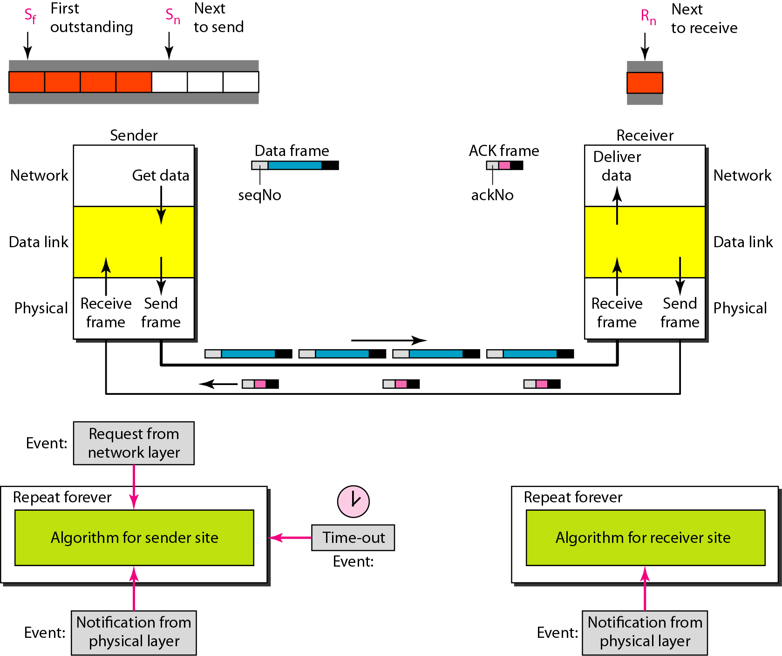
Design of Go-Back-N ARQ

Slide 24

Window size for Go-Back-N ARQ

Slide 25
In Go-Back-N ARQ, the size of the send window must be less than 2^{m};
the size of the receiver window
is always 1.
suppose the sender has already sent frame 6, but the timer for frame 3 expires. This means that frame 3 has not been acknowledged; the sender goes back and sends frames 3,4,5, and 6 again. That is why the protocol is called Go-Back-N ARQ.

Slide 26
Example 6
Figure 6 shows an example of Go-Back-N. This is an example of a case where the forward channel is reliable, but the reverse is not. No data frames are lost, but some ACKs are delayed and one is lost.
The example also shows how cumulative acknowledgments can help if acknowledgments are delayed or lost.
After initialization, there are seven sender events. Request events are triggered by data from the network layer; arrival events are triggered by acknowledgments from the physical layer.
There is no time-out event here because all outstanding frames are acknowledged before the timer expires.
Note that although ACK 2 is lost, ACK 3 serves as both ACK 2 and ACK 3.

Slide 27

Flow diagram for Example 6

Slide 28
Figure shows what happens when a frame is lost.
Frames 0, 1, 2, and 3 are sent. However, frame 1 is lost.
The receiver receives frames 2 and 3, but they are discarded because they are received out of order.
The sender receives no acknowledgment about frames 1, 2, or 3. Its timer finally expires.
The sender sends all outstanding frames (1, 2, and 3) because it does not know what is wrong.
Note that the resending of frames 1, 2, and 3 is the response to one single event.
When the sender is responding to this event, it cannot accept the triggering of other events. This means that when ACK 2 arrives, the sender is still busy with sending frame 3.

Slide 29
The physical layer must wait until this event is completed and the data link layer goes back to its sleeping state. We have shown a vertical line to indicate the delay. It is the same story with ACK 3; but when ACK 3 arrives, the sender is busy responding to ACK 2. It happens again when ACK 4 arrives. Note that before the second timer expires, all outstanding frames have been sent and the timer is stopped.

Slide 30

Flow diagram for Example 11.7

Slide 31
Trace down the sliding window with variables Sf, Sn and Rn for Node A and B. Assume that it supports bidirectional communication with GobackN ARQ. For node A and node B as sender, the value of m is 3 and 2 respectively. Assume that for every data frame acknowledgement frame is sent. ACK-Acknowledgement frame, DAT-Data frame
Time | Event at A | Event at B
1 | First 3 DAT are sent | First 4 DAT are sent
2 | 4 DAT are received from B and ACK frames are piggybacked with next 3 DAT of A | 3 DAT are received from A and ACK piggybacked with next 2 DAT of B
3 | 1 DAT from B is received successfully and 1 DAT is corrupted and ACK is sent for the successful received frame | 2 DAT are received and ACK is sent. 3rd DAT is lost during transmission and ACK is send for 2 frames.
4 | Last ACK sent is lost | Last ACK sent is lost

Slide 32
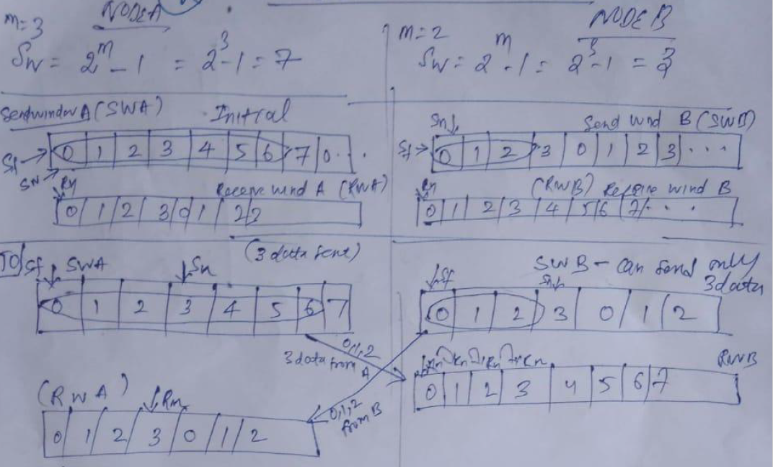

Slide 33
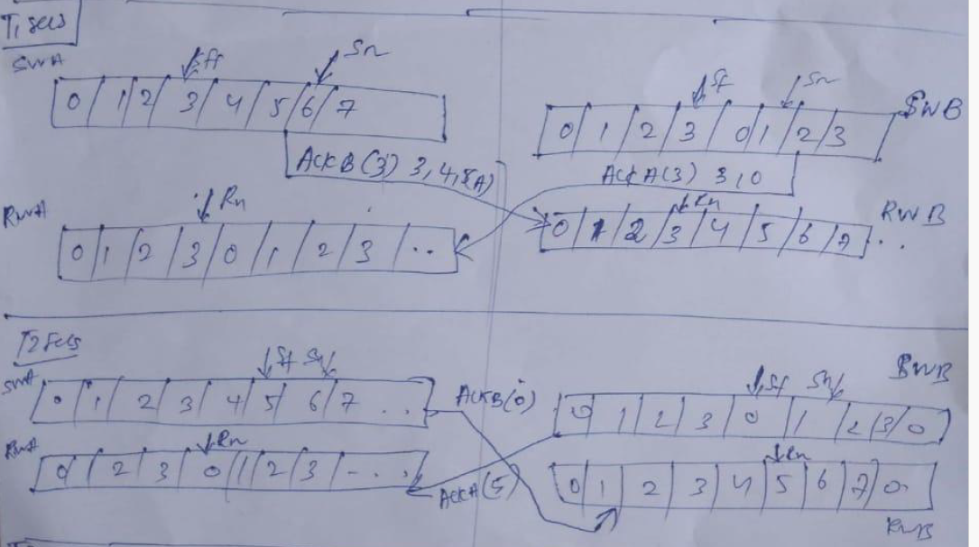

Slide 34
Selective Repeat ARQ

Slide 35
Stop-and-Wait ARQ is a special case of Go-Back-N ARQ in which the size of the send window is 1.

Slide 36

Send window for Selective Repeat ARQ

Slide 37

Receive window for Selective Repeat ARQ

Slide 38
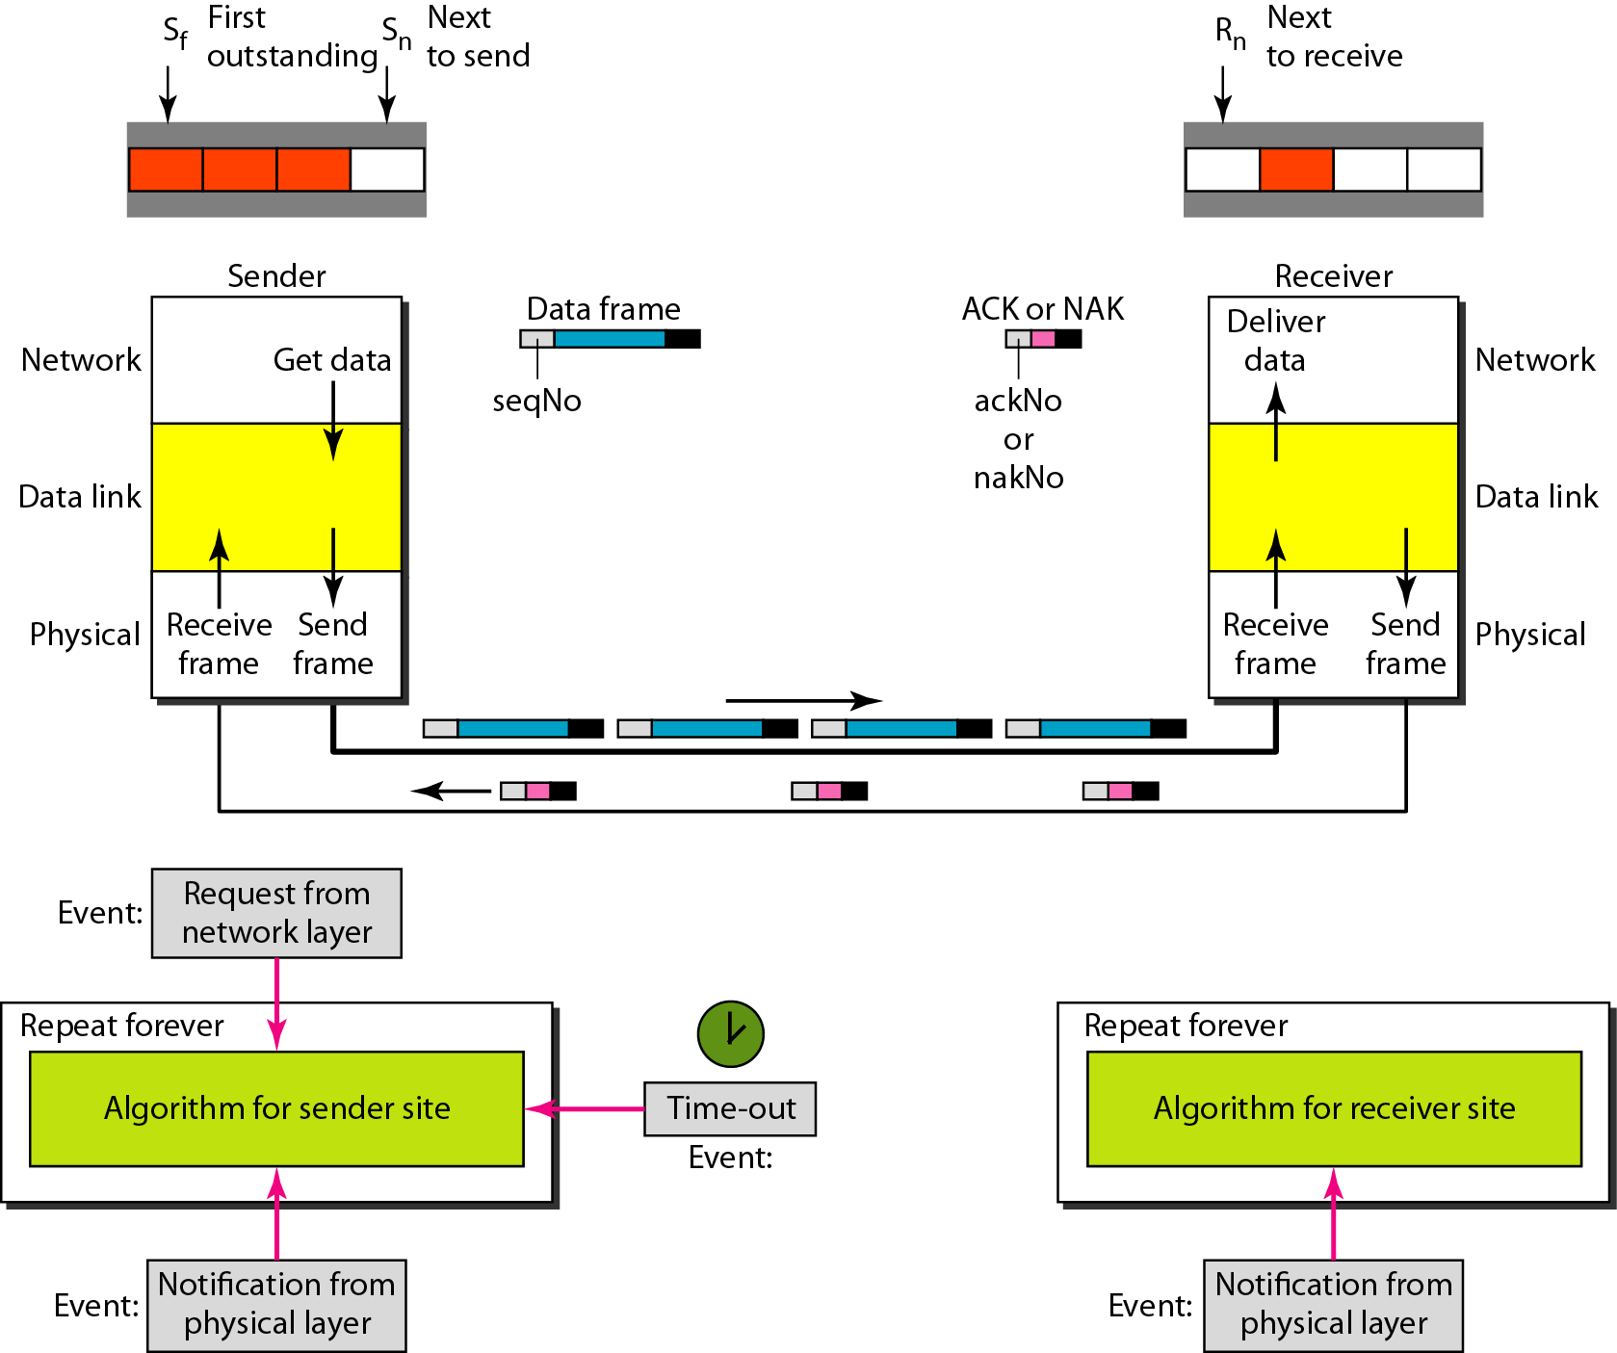
Design of Selective Repeat ARQ

Slide 39

Selective Repeat ARQ, window size

Slide 40
In Selective Repeat ARQ, the size of the sender and receiver window
must be at most one-half of 2^{m}.

Slide 41

Delivery of data in Selective Repeat ARQ

Slide 42
This example is similar to Example 11.3 in which frame 1 is lost. We show how Selective Repeat behaves in this case. Figure 11.23 shows the situation. One main difference is the number of timers. Here, each frame sent or resent needs a timer, which means that the timers need to be numbered (0, 1, 2, and 3). The timer for frame 0 starts at the first request, but stops when the ACK for this frame arrives. The timer for frame 1 starts at the second request, restarts when a NAK arrives, and finally stops when the last ACK arrives. The other two timers start when the corresponding frames are sent and stop at the last arrival event.

Slide 43
At the receiver site we need to distinguish between the acceptance of a frame and its delivery to the network layer. At the second arrival, frame 2 arrives and is stored and marked, but it cannot be delivered because frame 1 is missing. At the next arrival, frame 3 arrives and is marked and stored, but still none of the frames can be delivered. Only at the last arrival, when finally a copy of frame 1 arrives, can frames 1, 2, and 3 be delivered to the network layer. There are two conditions for the delivery of frames to the network layer: First, a set of consecutive frames must have arrived. Second, the set starts from the beginning of the window.

Slide 44
Another important point is that a NAK is sent after the second arrival, but not after the third, although both situations look the same. The reason is that the protocol does not want to crowd the network with unnecessary NAKs and unnecessary resent frames. The second NAK would still be NAK1 to inform the sender to resend frame 1 again; this has already been done. The first NAK sent is remembered (using the nakSent variable) and is not sent again until the frame slides. A NAK is sent once for each window position and defines the first slot in the window.

Slide 45
The next point is about the ACKs. Notice that only two ACKs are sent here. The first one acknowledges only the first frame; the second one acknowledges three frames. In Selective Repeat, ACKs are sent when data are delivered to the network layer. If the data belonging to n frames are delivered in one shot, only one ACK is sent for all of them.

Slide 46

Flow diagram for Example 8

Slide 47
Two neighboring nodes A and B use Selective Repeat ARQ with a 3 bit sequence number. Assuming that communication between A and B is bidirectional, show the window position and frame flow for the following sequence of events:-
Initial position. Before A and B sends any frames
After A sends 0, 1, 2 and B sends 2 Data frames with ACK 0 and ACK 1
A sends frames 3, 4 and then receives NAK 3 from B. B receives the corrupted frame 3 and sends 1 Data frame with ACK 4
A sends frames 3, 5, 6. The acknowledgement send by B is lost and A does not receive it.
Indicate the sender’s window size and Receiver’s window (S_{f}, S_{n} and S_{w}) at both A and B.

